Slide 1
Text Summarization
Presented by:
Niaz Ullah (cu-450-2018)
Main Shahbaz Rahim (cu-475-2018)
Mohammad Haseeb (cu-444-2018)

Slide 2

introduction
To develop the algorithm to summarize the texts.
Original doc → Summary text

Slide 3
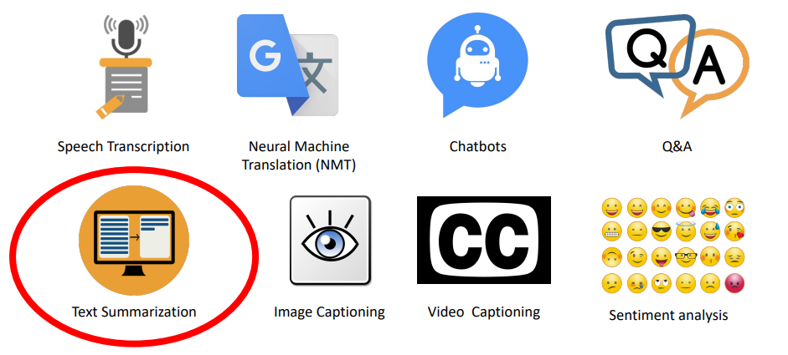
Natural language processing applications

Slide 4




Tools
Python
VS Code
Jupiter
Google Collab

Slide 5
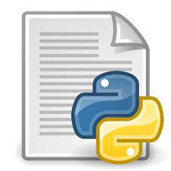
Libraries used
Sumy
PySummarization
BERT Summarizer

Slide 6

3 Algorithms Used
Frequency based algorithm
Luhn algorithm
Cosine similarity

Slide 7

Working of Frequency-based algorithm
Each sentence will have score.
Sentence with highest score will be selected as most important.

Slide 8

steps of Frequency-based algorithm
Preprocessing of the text
Calculate word frequency
Calculate word weight
Sentence tokenization
Score for the sentence
Order the sentences
Generate the summary

Slide 9
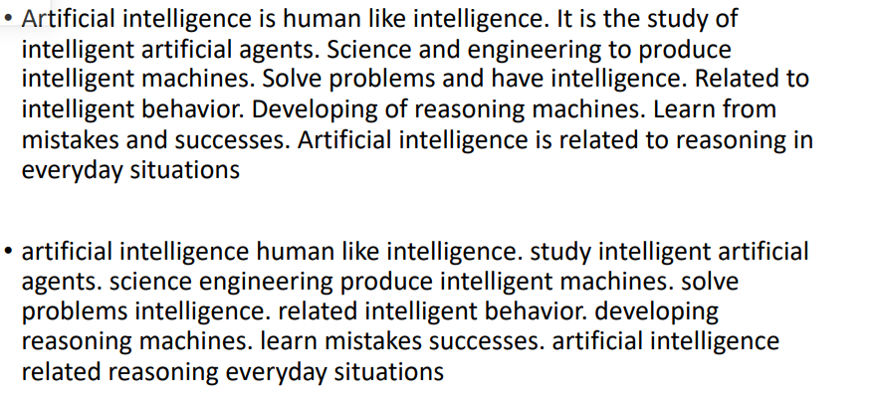
Preprocessing the text

Slide 10
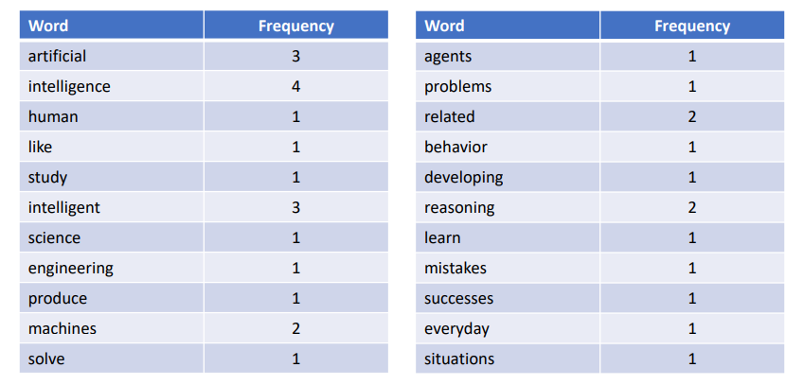
2. Word frequency

Slide 11
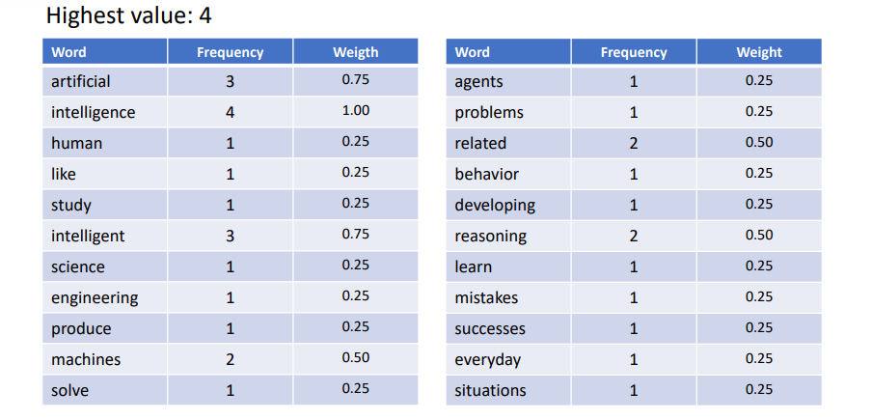
3. Weight of word frequency
Formula used
No . of times word appears(f)/ highest value

Slide 12
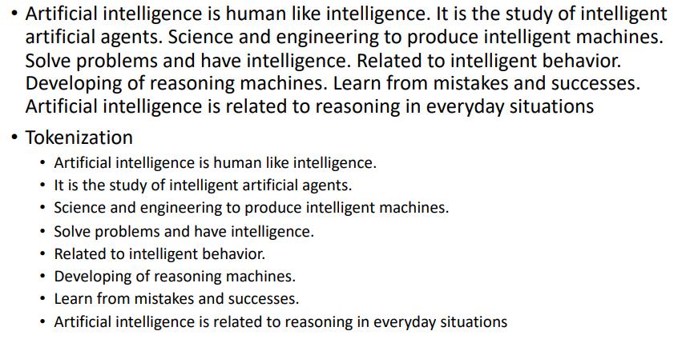
4. Sentence tokenization

Slide 13
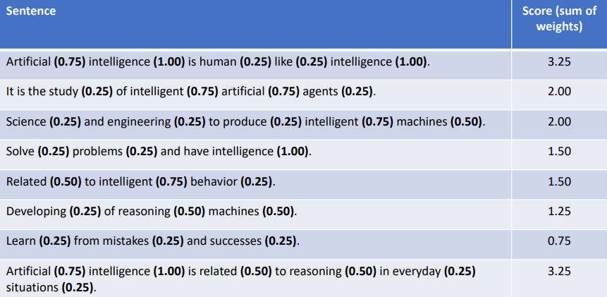
5. Score for the sentences

Slide 14
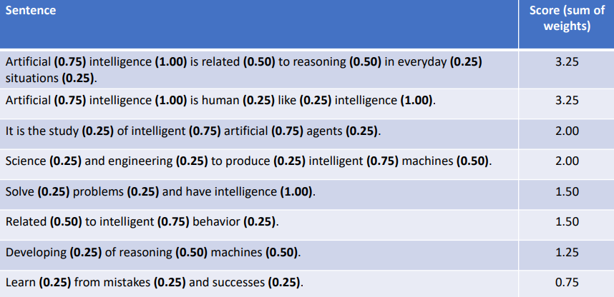
6. Order the sentences

Slide 15
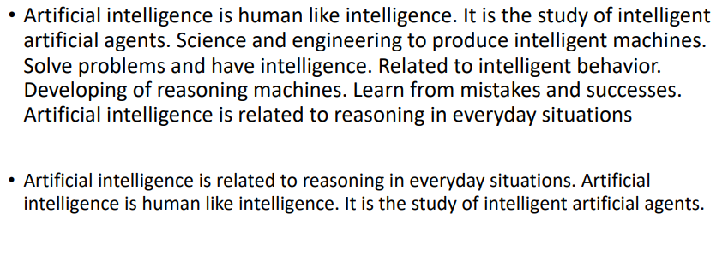
7. Generate the summary

